Slide 1
Chapter 11 Collections
FALL 2021

Slide 2
Objectives
In this chapter you will learn:
What collections are
To use the collections framework implementations
To use collections framework algorithms to manipulate collections
To use iterators to “walk through” a collection.

Slide 3
Collections Overview
Collection
Data structure (object) that can hold references to other objects
Collections Framework
Interfaces declare operations for various collection types
Provide high-performance, high-quality implementations of common data structures
Enable software reuse
Enhanced with generics capabilities in J2SE 5.0
Compile-time type checking
Some algorithms can be called polymorphically

Slide 4
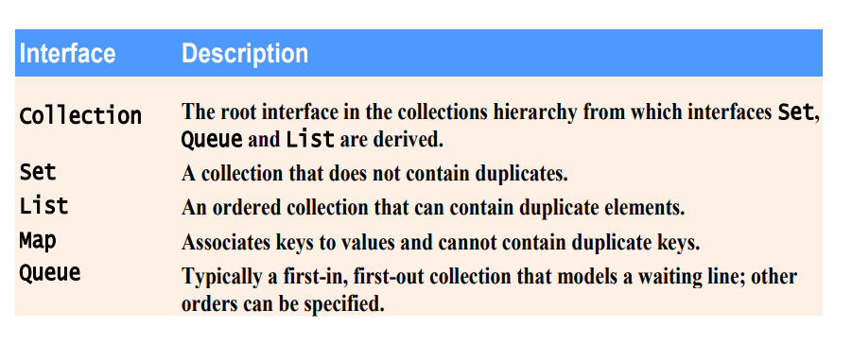
Some collection framework interfaces

Slide 5
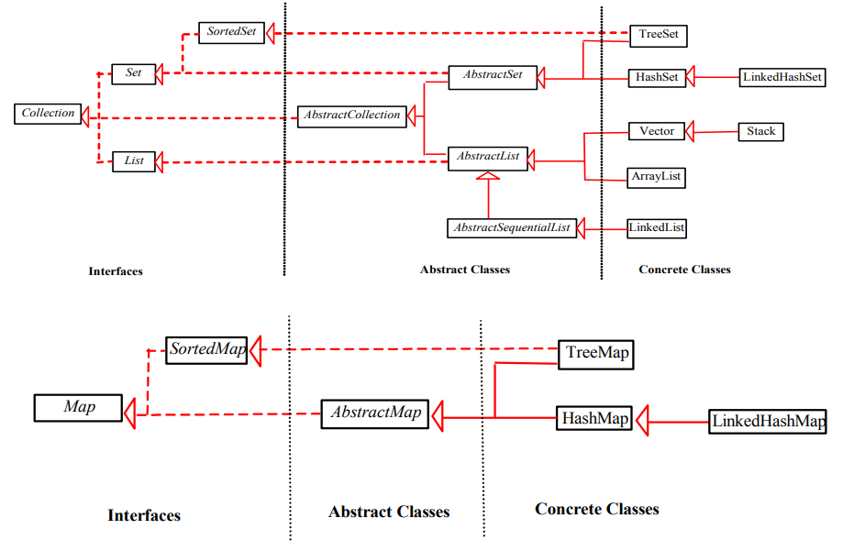
Some implementations in the API

Slide 6
Interface Collection
Root interface in the collection hierarchy
Interfaces Set, Queue, List extend interface Collection
Set – collection does not contain duplicates
Queue – collection represents a waiting line
List – ordered collection can contain duplicate elements
Contains bulk operations
Adding, clearing, comparing and retaining objects
Provide methods to return Iterator object
Walk through collection and remove elements from collection
An iterator generates a series of elements, one at a time. Successive calls to the next() method return successive elements of the collections.

Slide 7
The List Interface
List (interface)
The user of this interface has precise control over where in the list each element is inserted. The éléments can be accessed by their integer index.
Ordered collections can contain duplicate elements
Sometimes called a sequence
Implemented by the concrete classes:
ArrayList
LinkedList
Vector

Slide 8
ArrayList
Represents a resizable array that can grow dynamically at runtime
1 parameter to customize
The initial capacity, by default is 10
The ensureCapacity(int) behavior increases the capacity of this ArrayList instance, if necessary, to ensure that it can hold at least the number of elements specified in the minimum capacity argument
Example: Posted Online

Slide 9
LinkedList
LinkedList
Doubly linked and double ended implementation
Since it is a list implementation operations that index into the list will traverse the list from the beginning and the end, whichever is closer to the specific index (which might take a linear time).
Example: Posted Online

Slide 10
Vector
Class Vector
Array-like data structure that can grow or shrink as needed dynamically.
2 parameters to customize:
Initial capacity by default is 10
Capacity increment if it requires additional space, by default is 0
trimToSize() behavior trims the capacity of this vector to be the vector’s current size.
If the capacity of this vector is larger that its current size, then the capacity is changed to equal size by replacing its internal data array with a smaller one.
An application can use this operation to minimize the storage of a vector.

Slide 11
Stack Class
Stack
Implements a Last-in-first-out (LIFO) data structure
Extends class vector
Add behaviors push(), pop(), and isEmpty()

Slide 12
Interface Queue
Interface Queue
New Collection interface introduced in J2SE 5.0
Extends interface Collection
Provides additional operations for inserting, removing, and inspecting elements in a queue: offer(), poll(), and peek()
Class PriorityQueue
Implements the Queue interface
Implemented based on a priority heap
It has an initial capacity to customize, by default is 11
Order of elements:
The priority queue orders elements by their natural ordering, specified by Comparable element’s compareTo method
Otherwise supply comparator object through constructor

Slide 13
The interface Map
The Map interface is not a Collection
Associates keys to values
Data structure that uses hashing
Cannot contain duplicate keys
Called one-to-one mapping
Behaviors
To insert a key-value mapping put(key, value),
To get a value by key get(key)
To double check whether the map has a key containsKey(key)
And to get the set of keys keySet().

Slide 14
Maps (Cont.)
Implementation Classes
Hastable, HashMap
Hashtable
An instance of Hashtable has two parameters that can be customized and that affect its performance
Initial capacity is the number of buckets in the hash table by default is 11
Load factor (number of elements/capacity), is a measure of how full the hash tables allowed to get before its capacity is automatically increased, by default is 0.75.
HashMap
The default capacity (16) and the default load factor (0.75).
The only difference between Hashtable and HashMap is that HashMap is unsynchronized.

Slide 15
Maps (Cont.)
To successfully store and retrieve objects from HashMap or a Hashtable, the objects used as keys must implement the hashCode() method and the equals() method.
Minimizes collisions by separate chaining
Each table cell is a hash “bucket”
Linked list of all key-value pairs that hash to that cell

Slide 16
SortedMap Interface
Interface SortedMap
Extends Map
Maintains its key in sorted order
TreeMap class implements SortedMap
Store elements in trees (balanced red-back-tree)
Oder of elements:
Natural ordering specified by Comparable elements’ CompareTo method
Otherwise supply Comparator object through constructor
Behaviors:
subMap(K fromKey, K toKey) returns a view of the portion of this map whose keys range from fromKey inclusive, to toKey exclusive
tailMap(K fromKey) returns a view of the portion of the map whose keys are greater than or equal to fromKey

Slide 17
The interface Set
Set
Collection that contains unique elements and can’t be reordered
The class HashSet implements Set
Stores elements in a HashMap instance
The details of a HashMap apply

Slide 18
The SortedSet Interface
SortedSet
It extends Set
TreeSet implements SortedSet
Stores elements in a TreeMap instance
The details of a TreeMap apply

Slide 19
Abstract Implementations
These classes provide a skeletal implementations of Collection Interfaces, to minimize the effort required to implement this interface
Example of abstract implementations
AbstractCollection
AbstractList
AbstractMap
AbstractSequentialList
AbsractSet
AbstractQueue

Slide 20
The Class Collections
The class Collections provides static methods that manipulate collections polymorphically
Algorithms
List algorithms
Sort
binarySearch
Reverse
Shuffle
Fill
copy
Collection algorithms
Min
Max
addAll
Frequency
disjoint

Slide 21
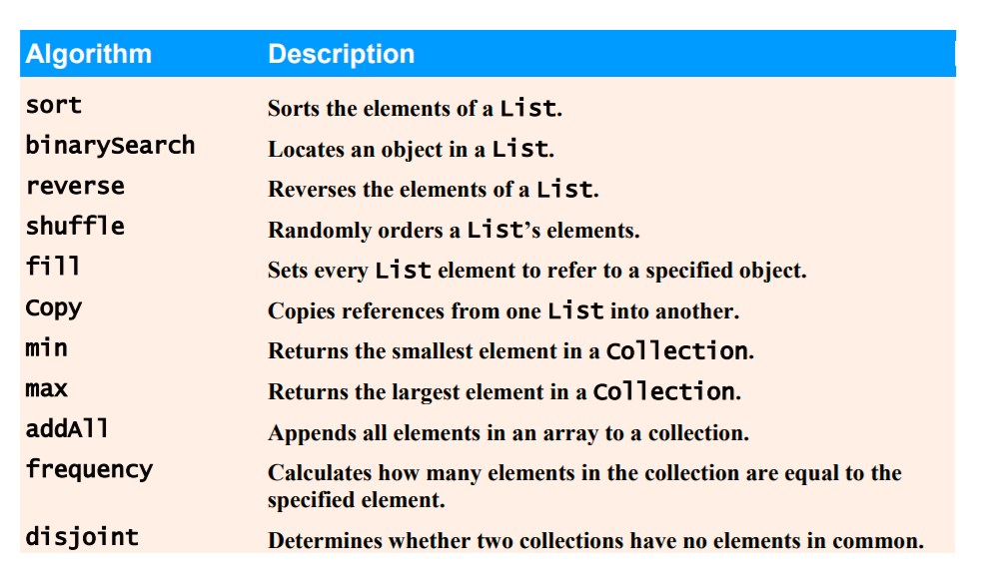
Collections Algorithms

Slide 22
Algorithm Sort
Sort
Sorts list of elements
Stable and based on modified version the merge sort algorithm
Order is determined by natural order of elements’ type where the objects in the list must implement the Comparable interface
Or supply a Comparator to the method sort
Runs in O(n*log2(n))

Slide 23
Code Example:
Posted online

Slide 24
Algorithm binarySearch
binarySearch
Locates object in List
Returns index of object in List if object exists
Returns negative value if Object does not exist
Calculate insertion point
Make the insertion point sign negative
Subtract 1 from insertion point
Passing an unsorted list to binarySearch is a logic error – the value returned is undefined

Slide 25
Class Arrays
Class Arrays
Provides static methods for manipulating arrays
Provides « high-level » methods
Method sort for sorting arrays
Method binarySearch for searching sorted arrays, passing an unsorted array to binarySearch in a logic error – the value returned in undefined
Method equals for comparing arrays
Method fill for placing values into arrays
Method asList allows to view an array as a List collection

Slide 26
Common Programming Error
List interface
<T> T[ ] toArray(T[ ] arr) returns an array containing all of the elements in the list in proper sequence
Passing an array that contains data to toArray can cause logic errors.
If array length is smaller than the size of the list on which toArray is called, a new array is allocated to store the list’s elements – without preserving the array argument’s elements.
If array length is greater than the size of the list on which toArray is called, the elements of the array (starting at index zero) are overwritten with the list’s elements. Array elements that are not overwritten retain their values

